Slide 1
Tree Definition A tree is a non-linear data structure that organizes data in a hierarchical structure.

Slide 2
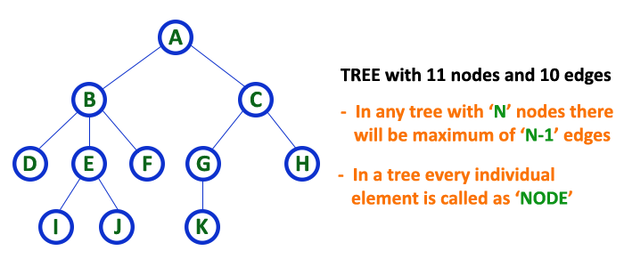

Slide 3
Tree terminology...
1.Root:
The first node is called as Root Node.
Every tree must have root node, there must be only one root node.
Root node doesn't have any parent also called as special node

Slide 4
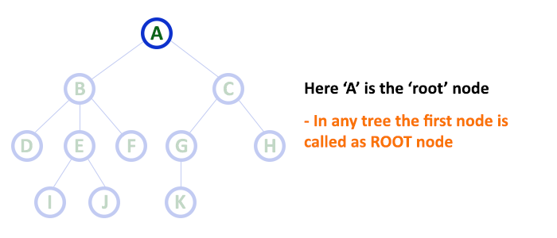

Slide 5
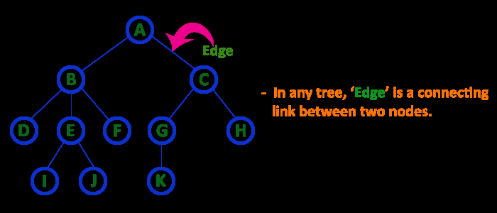
2. Edge
In a tree data structure, the connecting link between any two nodes is called as EDGE. In a tree with 'N' number of nodes there will be a maximum of 'N-1' number of edges.

Slide 6
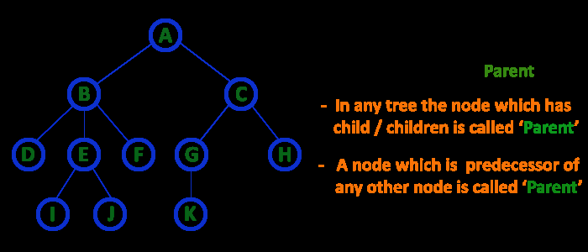
3. Parent
In a tree data structure, the node which is predecessor of any node is called as PARENT NODE. In simple words, the node which has branch from it to any other node is called as parent node. Parent node can also be defined as "The node which has child / children".

Slide 7
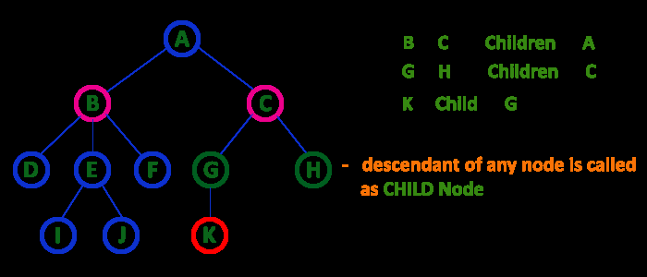
4. Child
The node which has a link from its parent node is called as child node.
In a tree, any parent node can have any number of child nodes.
In a tree, all the nodes except root are child nodes.

Slide 8
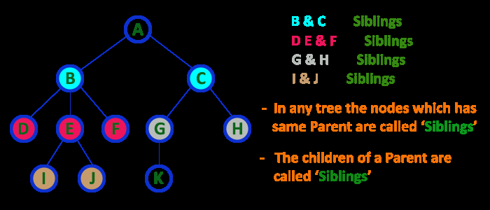
5. Siblings
The nodes with same parent are called as Sibling nodes.

Slide 9
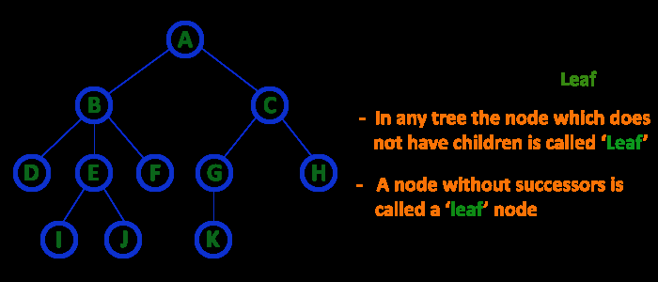
6. Leaf Node
The node which does not have a child is called as LEAF Node.
The leaf nodes are also called as External Nodes or 'Terminal' node.

Slide 10
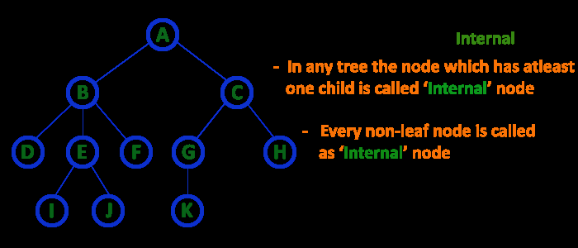
7. Internal Nodes
An internal node is a node with atleast one child.
Nodes other than leaf nodes are called as Internal Nodes.
The root node is also said to be Internal Node if the tree has more than one node. Internal nodes are also called as 'Non-Terminal' nodes.

Slide 11
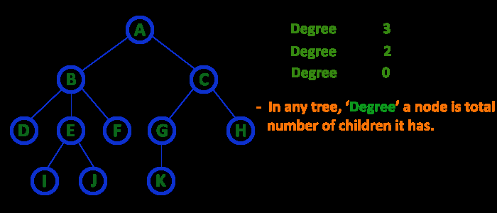
8. Degree
In a tree data structure, the total number of children of a node is called as DEGREE of that Node.

Slide 12
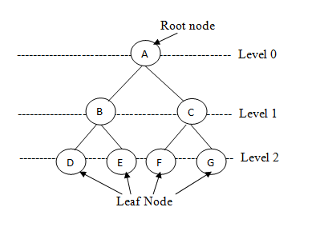
9. Level
In a tree data structure, the root node is said to be at Level 0 and the children of root node are at Level 1 and the children of the nodes which are at Level 1 will be at Level 2 and so on...
In a tree each step from top to bottom is called as a Level and the Level count starts with '0' and incremented by one at each level (Step).

Slide 13
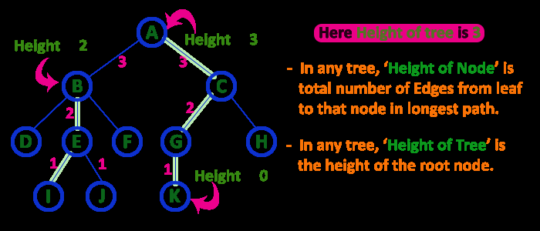
10. Height
the total number of egdes from leaf node to a particular node in the longest path is called as HEIGHT of that Node.
In a tree, height of the root node is said to be height of the tree.

Slide 14
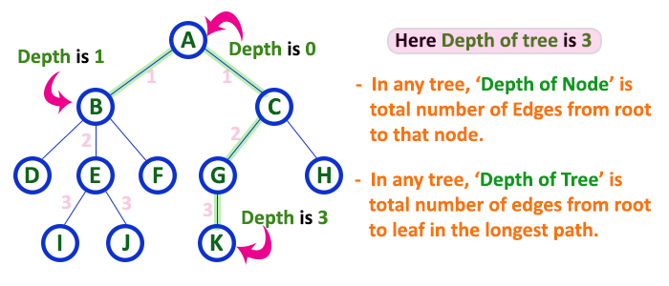
11. Depth
In a tree data structure, the total number of egdes from root node to a particular node is called as DEPTH of that Node.

Slide 15
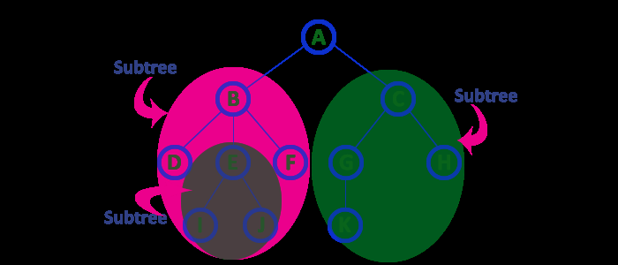
12. Sub Tree
Every child node will form a subtree on its parent node.

Slide 16
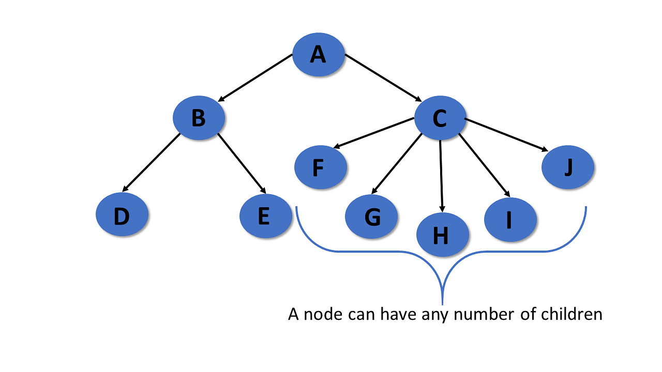
Types of Trees
General Tree
Binary Tree
Binary Search Tree
AVL Tree
General Tree
The general tree is the type of tree where there are no constraints on the hierarchical structure.
Properties
The general tree follows all properties of the tree data structure.
A node can have any number of nodes.

Slide 17
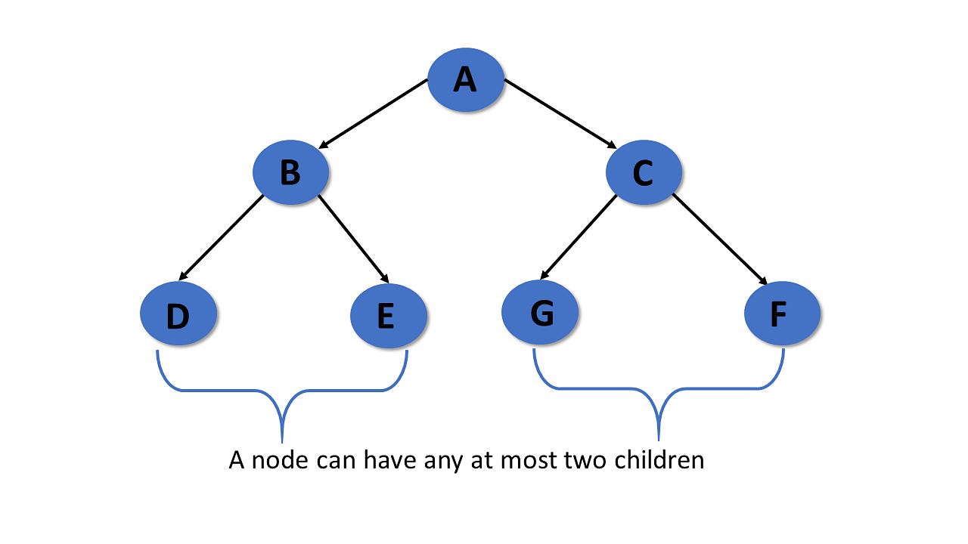
Binary Tree
A binary tree has the following properties:
Properties
Follows all properties of the tree data structure.
Binary trees can have at most two child nodes.
These two children are called the left child and the right child.
Binary Tree Representation
Using Array
Linked List

Slide 18
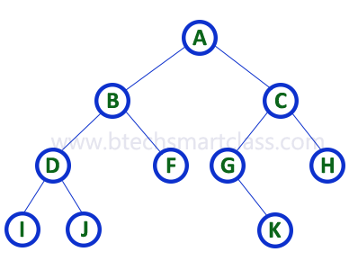

Binary Tree Representation
Array Representation of Binary Tree
In array representation of a binary tree, we use one-dimensional array (1-D Array) to represent a binary tree. Consider the above example of a binary tree and it is represented as follows...
To represent a binary tree of depth 'n' using array representation, we need one dimensional array with a maximum size of 2n + 1.

Slide 19
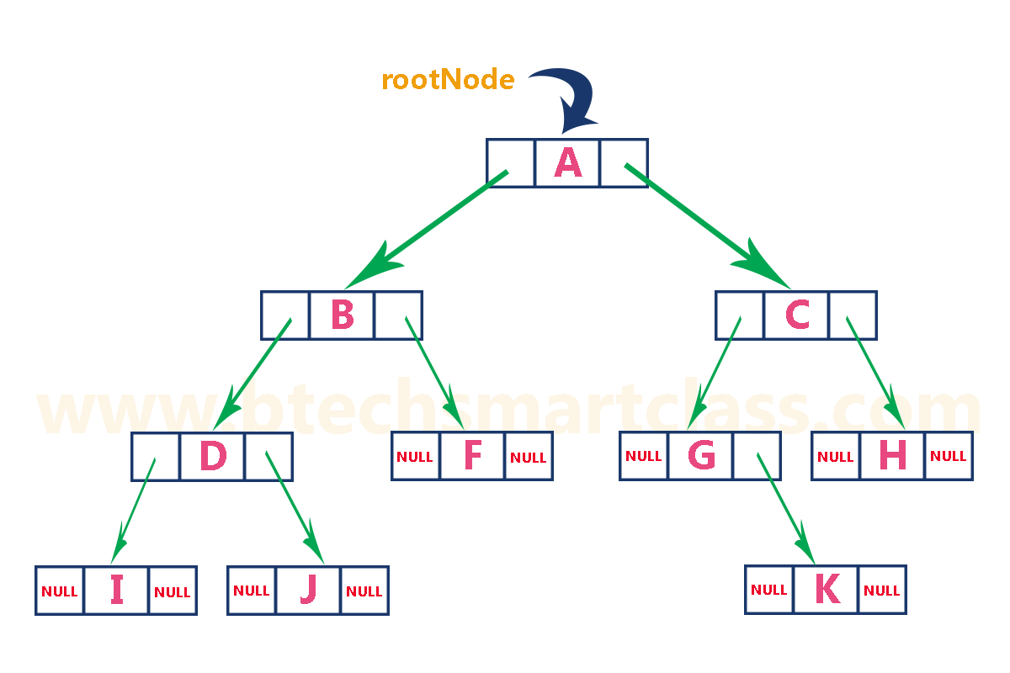

Binary Tree Representation
2.Linked List Representation of Binary Tree
We use a double linked list to represent a binary tree.
In a double linked list, every node consists of three fields.
First field for storing left child address, second for storing actual data and third for storing right child address. In this linked list representation, a node has the following structure...

Slide 20
Binary Tree
Types of Binary Tree
There are five types of Binary tree:
Full/ proper/ strict Binary tree
Complete Binary tree
Perfect Binary tree
Degenerate Binary tree
Balanced Binary tree

Slide 21
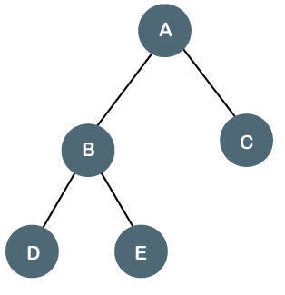

1. Full/ proper/ strict Binary tree
The full binary tree is also known as a strict binary tree.
The tree can only be considered as the full binary tree if each node must contain either 0 or 2 children.
The full binary tree can also be defined as the tree in which each node must contain 2 children except the leaf nodes.

Slide 22
1. Full/ proper/ strict Binary tree
Properties of Full Binary Tree
The number of leaf nodes is equal to the number of internal nodes plus 1. In the below example, the number of internal nodes is 3; therefore, the number of leaf nodes is equal to 4.
The maximum number of nodes is the same as the number of nodes in the binary tree, i.e., 2^{h+1} -1.
The minimum number of nodes in the full binary tree is 2*h-1.
The minimum height of the full binary tree is log₂(n+1) - 1.
The maximum height of the full binary tree can be computed as: h = n+1/2

Slide 23
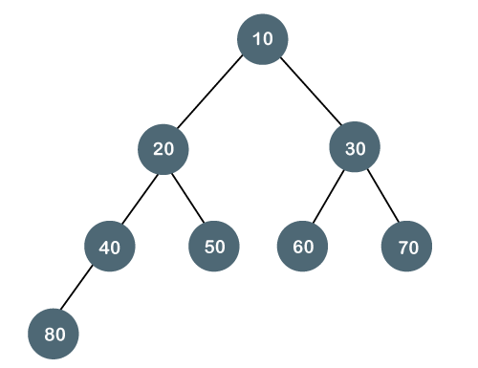

Complete Binary Tree
The complete binary tree is a tree in which all the nodes are completely filled except the last level. In the last level, all the nodes must be as left as possible.
In a complete binary tree, the nodes should be added from the left.
Properties of Complete Binary Tree
The maximum number of nodes in complete binary tree is 2^{h+1} - 1.
The minimum number of nodes in complete binary tree is 2^{h}.
The minimum height of a complete binary tree is log₂(n+1) - 1.
The maximum height of a complete binary tree is:(n+1)/2

Slide 24
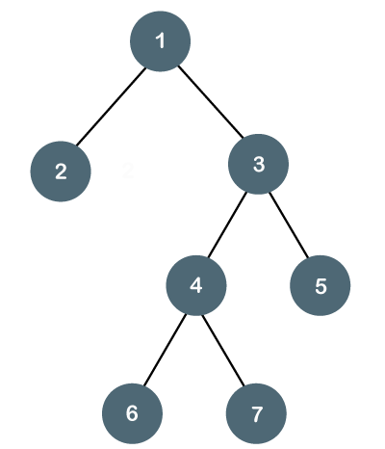
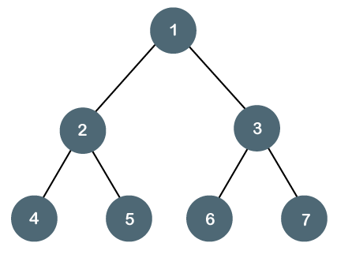
Perfect Binary Tree
A tree is a perfect binary tree if all the internal nodes have 2 children, and all the leaf nodes are at the same level.

Slide 25
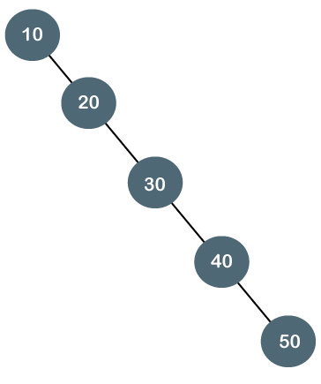
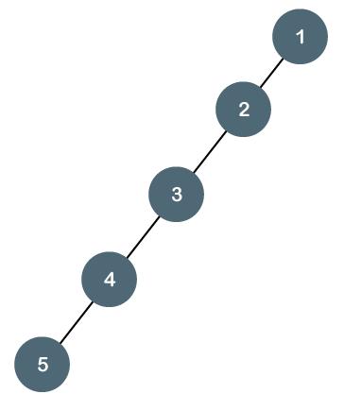
Degenerate Binary Tree
The degenerate binary tree is a tree in which all the internal nodes have only one children.
The above tree is a degenerate binary tree because all the nodes have only one child. It is also known as a right-skewed tree as all the nodes have a right child only.
The above tree is also a degenerate binary tree because all the nodes have only one child. It is also known as a left-skewed tree as all the nodes have a left child only.

Slide 26
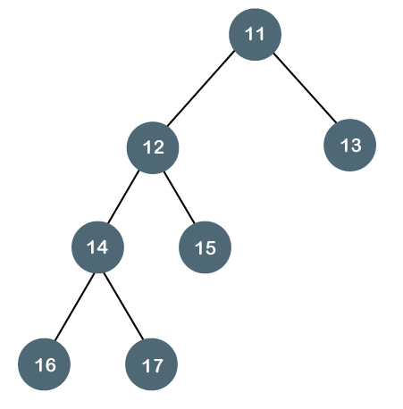
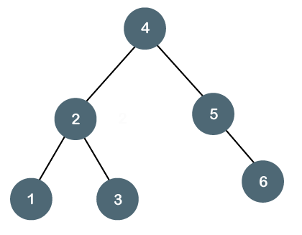
Balanced Binary Tree
The balanced binary tree is a tree in which both the left and right trees differ by at most 1 i.e -1,0,1
The above tree is a balanced binary tree because the difference between the left subtree and right subtree is zero
The above tree is not a balanced binary tree because the difference between the left subtree and the right subtree is greater than 1.

Slide 27
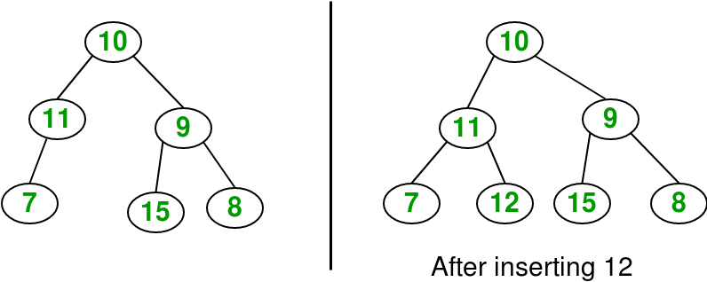
Operations Binary Tree
Insertion
Deletion
Input : Delete 10 in below tree
10 / \ 20 30
Output: 30 / 20

Slide 28
Operations Binary Tree
Traversal
Pre-order
In-order
Post-order

Slide 29
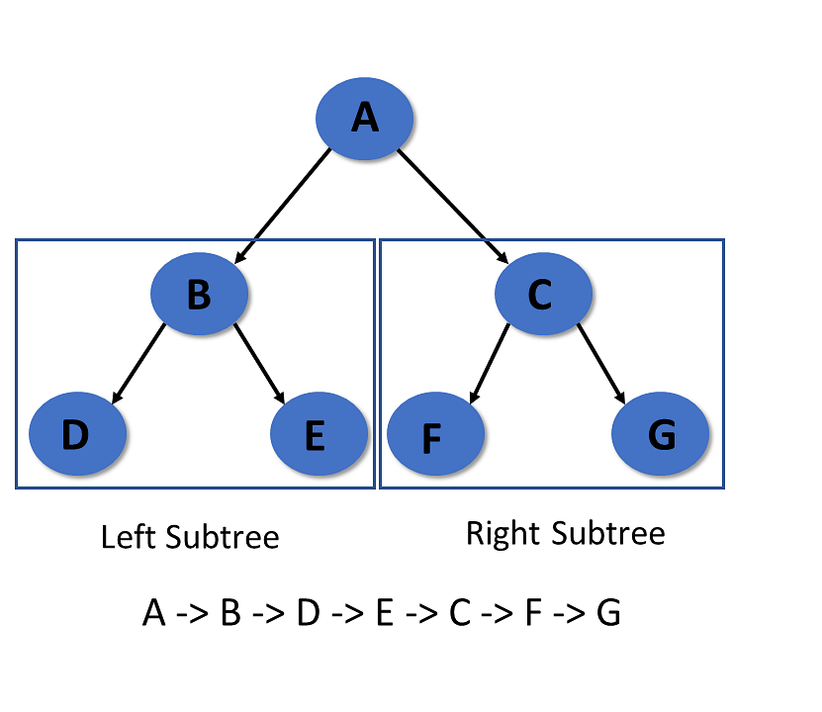
Operations Binary Tree
Pre-order Traversal
In pre-order traversal, it visits the root node first,
then the left subtree, and lastly right subtree.
Algorithm:
Step 1- Visit root node
Step 2- Recursively traverse the left subtree
Step 3- Recursively traverse right subtree

Slide 30

Operations Binary Tree
In-order Traversal
In the in-order traversal, the left subtree is visited first, then the root, and later the right subtree.
Algorithm:
Step 1- Recursively traverse the left subtree
Step 2- Visit root node
Step 3- Recursively traverse right subtree

Slide 31

Operations Binary Tree
Post-order Traversal
It visits the left subtree first in post-order traversal, then the right subtree, and finally the root node.
Algorithm:
Step 1- Recursively traverse the left subtree
Step 2- Visit root node
Step 3- Recursively traverse right subtree

Slide 32
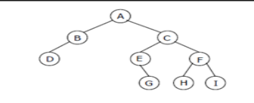

Slide 33
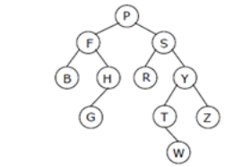

Slide 34

Expression trees
Expression trees are binary tree data structures where internal nodes represent operators and leaf nodes represent operands, used to represent arithmetic, logical, and even code-like expressions

Slide 35
What are Expression Trees?
Binary Tree Structure: An expression tree is a specific type of binary tree.
Operators and Operands:
Internal Nodes: These are the non-leaf nodes and represent operators (e.g., +, -, *, /, <, >).
Leaf Nodes: These are the final nodes and represent operands (e.g., numbers, variables, or constants).
Types of Expressions: They can represent various expressions, including arithmetic, boolean, and even code structures like Lambda expressions.

Slide 36
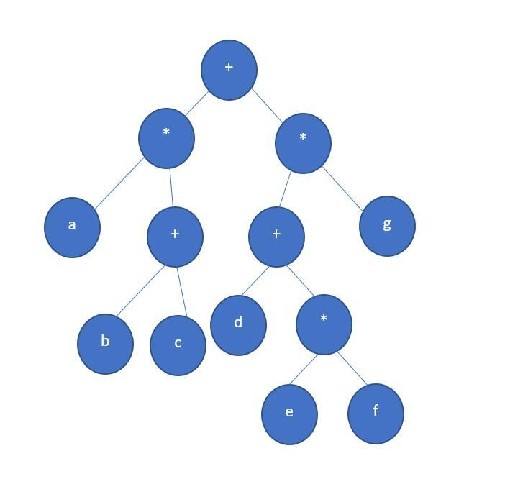
Draw the expression tree for the expression: a*( b + c ) + ((d + e*f)*g)

Slide 37

Prefix expression Algorithm:
Read the prefix expression from right to left.
Initialize an empty stack.
For each symbol:
If the symbol is an operand, create a single-node tree with the operand and push it onto the stack.
If the symbol is an operator, pop the top two pointers to sub-trees from the stack (let's call them T1 and T2). Create a new tree with the operator as the root, with T1 as its right child and T2 as its left child. Push a pointer to this new tree onto the stack. This is because we are processing from right to left.
After all symbols have been processed, the stack will contain a single pointer to the root of the complete expression tree.

Slide 38

Postfix expression Algorithm
Read the postfix expression from left to right.
Initialize an empty stack.
For each symbol:
If the symbol is an operand, create a single-node tree for that operand and push it onto the stack.
If the symbol is an operator, pop the top two pointers to sub-trees from the stack (let's call them T2 and T1). Create a new tree with the operator as the root, with T1 as its left child and T2 as its right child. Push a pointer to this new tree onto the stack.
After all symbols have been processed, the stack will contain a single pointer to the root of the complete expression tree

Slide 39
Constructing a Binary
Given pre-order and in-order
In-order: [40, 20, 50, 10, 60, 30],
Pre-order: [10, 20, 40, 50, 30, 60]
In-order sequence: D B E A F C
Pre-order sequence: A B D E C F
Pre-order = [3,9,20,15,7],
In-order = [9,3,15,20,7]
Pre-order = [A,B,C,D,E,F]
In-order = [F,E,D,C,B,A]

Slide 40


Binary search tree
A binary search tree is a binary tree.
a. It may be empty.
b. If it is not empty then it satisfies the following properties:
1. Every element has a key and no two elements have the same key. 2. The keys in the left subtree are smaller than the key in the root.
3. The keys in the right subtree are larger than the key in the root.
4. The left and right subtrees are also binary search trees

Slide 41
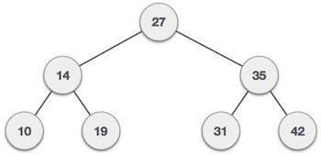
Binary Search Tree
A binary search tree is a type of tree that is a more constricted extension of a binary tree data structure.
Properties
Follows all properties of the tree data structure.
The binary search tree has a unique property known as the binary search property.
This states that the value of a left child node of the tree should be less than or equal to the parent node value of the tree.
And the value of the right child node should be greater than or equal to the parent value.

Slide 42
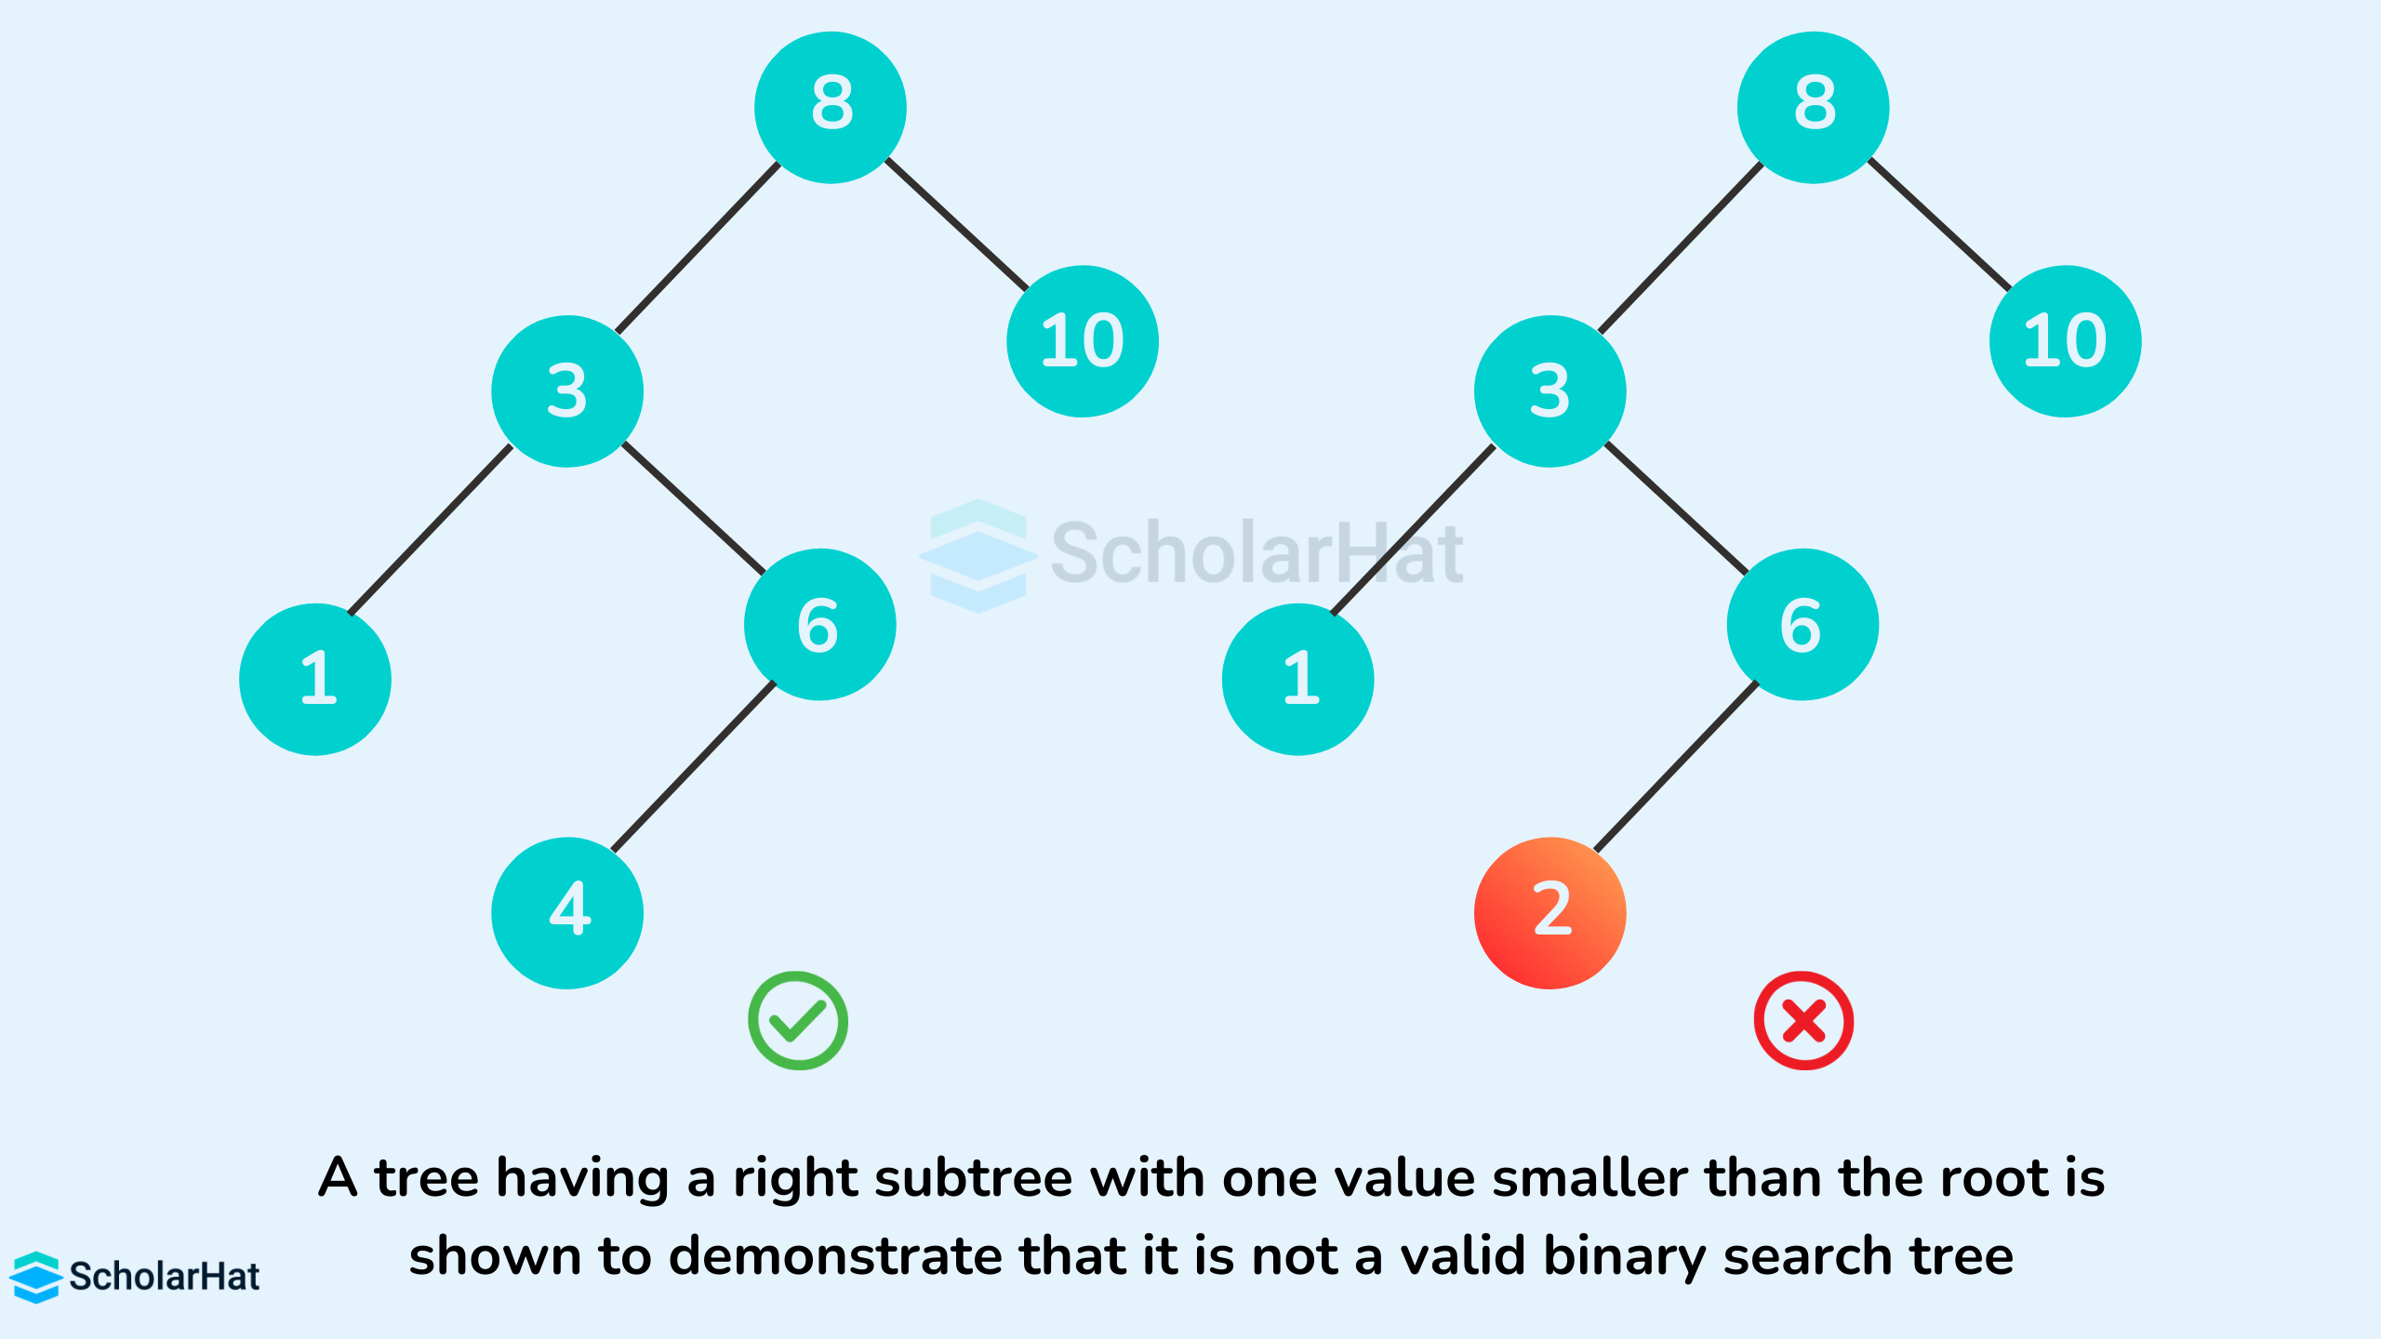
Binary Search Tree

Slide 43
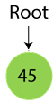
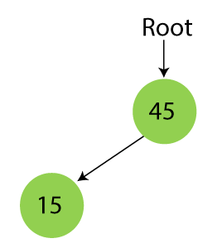
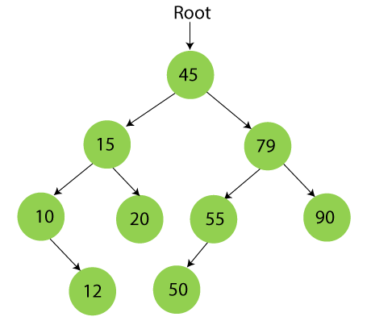

Creation of Binary Search Tree
Suppose the data elements are - 45, 15, 79, 90, 10, 55, 12, 20, 50

Slide 44
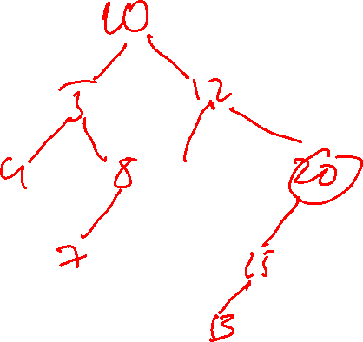
Construct a Binary Search Tree
Construct a Binary Search Tree by inserting the following sequence of numbers... 10,12,5,4,20,8,7,15 and 13

Slide 45
Searching in Binary Search Tree
First, compare the element to be searched with the root element of the tree.
If root is matched with the target element, then return the node's location.
If it is not matched, then check whether the item is less than the root element, if it is smaller than the root element, then move to the left subtree.
If it is larger than the root element, then move to the right subtree.
Repeat the above procedure recursively until the match is found.
If the element is not found or not present in the tree, then return NULL.

Slide 46
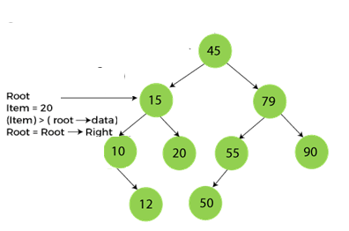
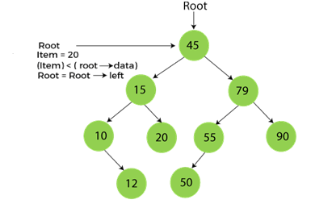
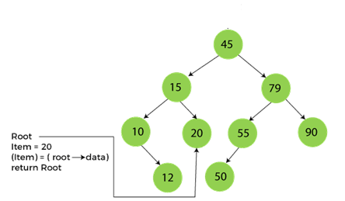

Searching in Binary Search Tree
Step1:
Step2:
Step3:

Slide 47

The search operation is performed as follows...
Step 1: Read the search element from the user
Step 2: Compare, the search element with the value of root node in the tree.
Step 3: If both are matching, then display "Given node found" and terminate the function
Step 4: If both are not matching, then check whether search element is smaller or larger than that
node value.
Step 5: If search element is smaller, then continue the search process in left subtree.
Step 6: If search element is larger, then continue the search process in right subtree.
Step 7: Repeat the same until we found exact element or we completed with a leaf node
Step 8: If we reach to the node with search value, then display "Element is found" and terminate the
function.
Step 9: If we reach to a leaf node and it is also not matching, then display "Element not found" and
terminate the function.

Slide 48
struct node* search(struct node *root, int key)
{
// Base Cases: root is null or key is present at root
if (root == NULL || root->key == key)
return root;
if (key > root->key ) // Key is greater than root's key
return search(root->right, key);
else // Key is smaller than root's key
return search(root->left, key);
}

Slide 49
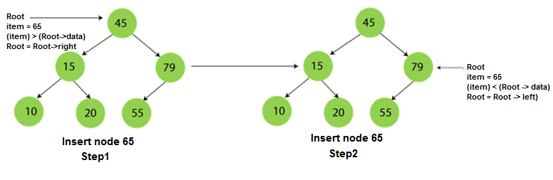
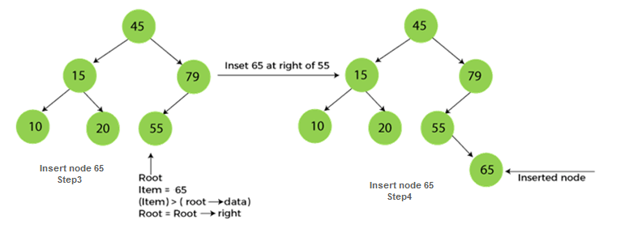
Insertion in Binary Search Tree

Slide 50
The insertion operation is performed as follows
Step 1: Create a newNode with given value and set its left and right to NULL.
Step 2: Check whether tree is Empty.
Step 3: If the tree is Empty, then set set root to newNode.
Step 4: If the tree is Not Empty, then check whether value of newNode is smaller or larger than the node (here it is root node).
Step 5: If newNode is smaller than or equal to the node, then move to its left child.
If newNode is larger than the node, then move to its right child.
Step 6: Repeat the above step until we reach to a leaf node (e.i., reach to NULL).
Step 7: After reaching a leaf node,
a) then isert the newNode as left child if newNode is smaller or equal to that leaf,
b) otherwise insert it as right child.

Slide 51
void insert(node *root, node *new )
{ if(root == NULL)
root = new;
else
{
if(new->data < = root->data)
{ if(root->left != NULL)
insert(root->left, new);
else
root->left = new;
}
if(new->data > root->data)
{
if(root->right != NULL)
insert(root->right, new);
else
root->right = new;
} } }

Slide 52
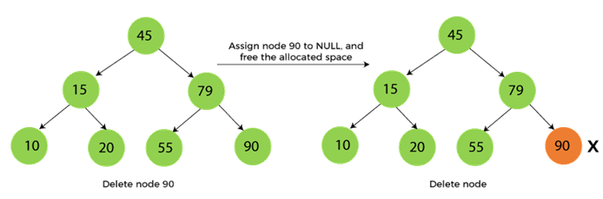
Deletion in Binary Search Tree
The node to be deleted is the leaf node, or,
The node to be deleted has only one child, and,
The node to be deleted has two children
When the node to be deleted is the leaf node

Slide 53
Case 1:
Deleting a leaf node We use the following steps to delete a leaf node from BST...
Step 1: Find the node to be deleted using search operation
Step 2: Delete the node using free function (If it is a leaf) and terminate the function.

Slide 54
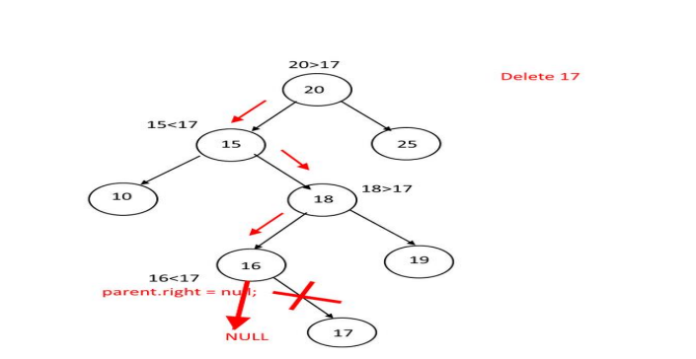

Slide 55
Case 2: Deleting a node with one child
We use the following steps to delete a node with one child from BST...
Step 1: Find the node to be deleted using search operation
Step 2: If it has only one child, then create a link between its parent and child nodes.
Step 3: Delete the node using free function and terminate the function.

Slide 56
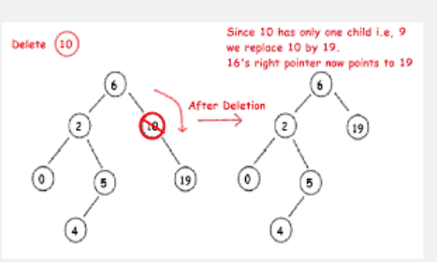

Slide 57
Case 3: Deleting a node with two children
We use the following steps to delete a node with two children from BST...
Step 1: Find the node to be deleted using search operation
Step 2: If it has two children, then find the largest node in its left subtree (OR)
the smallest node in its right subtree.
Step 3: Swap both deleting node and node which found in above step.
Step 4: Then, check whether deleting node came to case 1 or case 2 else goto steps 2
Step 5: If it comes to case 1, then delete using case 1 logic.
Step 6: If it comes to case 2, then delete using case 2 logic.
Step 7: Repeat the same process until node is deleted from the tree

Slide 58
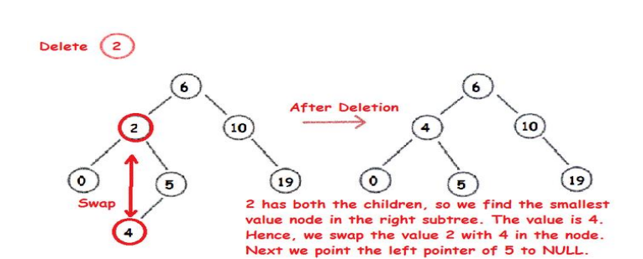

Slide 59
Make_null (or Initialize)
This operation creates an empty Binary Search Tree. It typically involves setting the root of the tree to null (or equivalent for the chosen programming language), signifying that no nodes are present in the tree.

Slide 60

Find_min
The Find_min operation efficiently locates the smallest key in the BST. Due to the BST property, the minimum element is always found at the leftmost node of the tree.
Start at the root.
Continuously traverse to the left child until a node with no left child is encountered. This node contains the minimum key.

Slide 61

function Find_min(root):
if root is null:
return null
while root->left is not null:
root = root->left
return root

Slide 62
MIN value
void smallest(struct node *root)
{
while(root != NULL && root->left != NULL)
{
root = root->left;
}
printf("\nSmallest value is %d\n", root->info);
}

Slide 63

Find_max
The Find_max operation efficiently locates the largest key in the BST. Similar to Find_min, the maximum element is always found at the rightmost node of the tree.
Start at the root.
Continuously traverse to the right child until a node with no right child is encountered. This node contains the maximum key.

Slide 64
Max value
void largest(struct node *root)
{
while (root != NULL && root->right != NULL)
{
root = root->right;
}
printf("\nLargest value is %d", root->info);
}

Slide 65

function Find_max(root):
if root is null:
return null
while root->right is not null:
root = root->right
return root

Slide 66
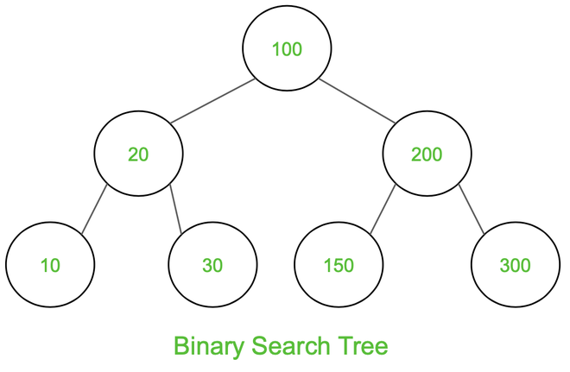
Binary Search Tree Traversal (In-order, Pre-order, Post-order

Slide 67
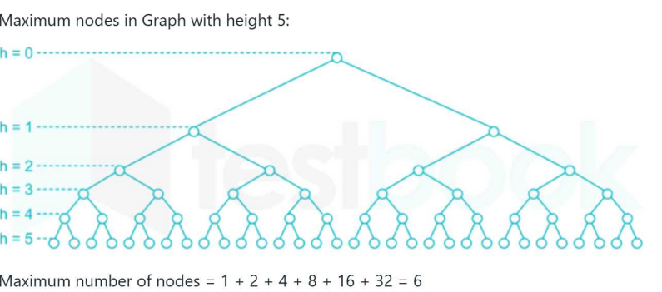

Slide 68
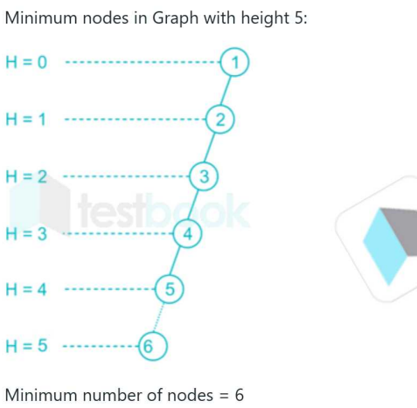

Slide 69
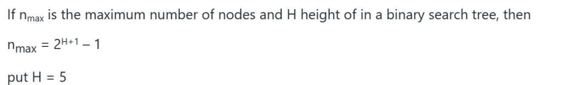


Slide 70
AVL Tree
AVL tree is a self balanced binary search tree. That means, an AVL tree is also a binary search tree but it is a balanced tree.
A binary tree is said to be balanced, if the difference between the hieghts of left and right subtrees of every node in the tree is either -1, 0 or +1.
In other words, a binary tree is said to be balanced if for every node, height of its children differ by at most one.
In an AVL tree, every node maintains a extra information known as balance factor.
The AVL tree was introduced in the year of 1962 by G.M. Adelson-Velsky and E.M. Landis.

Slide 71
Definition:
An AVL tree is a balanced binary search tree. In an AVL tree, balance factor of every node is either -1, 0 or +1.
Balance factor of a node is the difference between the heights of left and right subtrees of that node. The balance factor of a node is calculated either height of left subtree - height of right subtree (OR) height of right subtree - height of left subtree.
Balance factor = height Of LeftSubtree – height Of RightSubtree

Slide 72
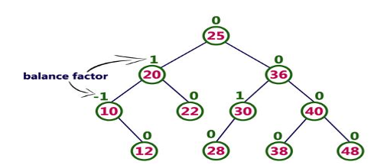

Example:
The below tree is a binary search tree and every node is satisfying balance factor condition. So this tree is said to be an AVL tree.

Slide 73

AVL Tree Rotations
Rotation is the process of moving the nodes to either left or right to make tree balanced.
There are four rotations and they are classified into two types.

Slide 74

Single left rotation
A single left rotation in an AVL tree is performed to rebalance the tree when an imbalance occurs due to an insertion into the right subtree of a right child. This scenario is often referred to as an "RR imbalance" or "Right-Right case

Slide 75

Single right rotation
A single right rotation in an AVL tree is a rebalancing operation performed when an imbalance occurs due to an insertion in the left subtree of a left child (often referred to as an "LL" case)

Slide 76

Left-Right (LR)
A Left-Right (LR) rotation in an AVL tree is a two-step process used to rebalance the tree when a new node is inserted into the right subtree of the left child, causing a left-heavy imbalance at the parent node and a right-heavy imbalance at the left child

Slide 77
When is an LR Rotation Needed?
An LR rotation is performed when the following conditions are met:
An imbalance is detected at a node (let's call it A) that has a balance factor of -2 (left-heavy).
The left child of A (let's call it B) has a balance factor of +1 (right-heavy).
The new node causing the imbalance is inserted into the right subtree of B

Slide 78

Right –Left Rotation
A right-left rotation in an AVL tree is performed when a node becomes unbalanced with a balance factor of +2 (right-heavy) and its right child is left-heavy (balance factor of -1)

Slide 79
operations are performed on an AVL tree
The following operations are performed on an AVL tree...
1. Search
2. Insertion
3. Deletion

Slide 80
Search Operation in AVL Tree
We use the following steps to search an element in AVL tree...
Step 1: Read the search element from the user
Step 2: Compare, the search element with the value of root node in the tree.
Step 3: If both are matching, then display "Given node found!!!" and terminate the function
Step 4: If both are not matching, then check whether search element is smaller or larger than that node value.
Step 5: If search element is smaller, then continue the search process in left subtree.
Step 6: If search element is larger, then continue the search process in right subtree.
Step 7: Repeat the same until we found exact element or we completed with a leaf node
Step 8: If we reach to the node with search value, then display "Element is found" and terminate the function. Step 9: If we reach to a leaf node and it is also not matching, then display "Element not found" and terminate the function.

Slide 81
Insertion Operation in AVL Tree
In an AVL tree, the insertion operation is performed with O(log n) time complexity. In AVL Tree, new node is always inserted as a leaf node.
The insertion operation is performed as follows...
Step 1: Insert the new element into the tree using Binary Search Tree insertion logic.
Step 2: After insertion, check the Balance Factor of every node.
Step 3: If the Balance Factor of every node is 0 or 1 or -1 then go for next operation.
Step 4: If the Balance Factor of any node is other than 0 or 1 or -1 then tree is said to be imbalanced.
Then perform the suitable Rotation to make it balanced. And go for next operation.

Slide 82

Construct an AVL Tree by inserting numbers from 1 to 8.

Slide 83


Slide 84


Slide 85

Construction of the AVL Tree for the given Sequence 21, 26, 30, 9, 4, 14, 28, 18,15,10, 2, 3, 7

Slide 86
Deletion Operation
in AVL Tree In an AVL Tree, the deletion operation is similar to deletion operation in BST. But after every deletion operation we need to check with the Balance Factor condition. If the tree is balanced after deletion then go for next operation otherwise perform the suitable rotation to make the tree Balanced.

Slide 87

Case -1

Slide 88

Case -2

Slide 89

Case -3

Slide 90



Slide 91
B-tree
A B-tree is a self-balancing tree data structure used for efficiently storing and retrieving large amounts of data, especially from disk-based storage systems. Unlike binary search trees, which store a single key per node, B-trees allow each node to store multiple keys and have multiple children.
In a B-Tree of order m, each node can have up to m children and m-1 keys, allowing it to efficiently manage large datasets.

Slide 92
Key Characteristics of B-Trees
Multiple Keys per Node: Each node in a B-tree can hold multiple keys, allowing for a compact representation of data.
Multiple Children: Corresponding to the number of keys, each non-leaf node can have many child nodes.
Self-Balancing: B-trees are designed to maintain balance by ensuring all leaf nodes are at the same level (depth).
Optimized for Disk Access: The low height of a B-tree minimizes the number of disk reads needed to find data, a critical advantage in disk-based systems where I/O operations are slow.
Defined by an "Order": The "order" of a B-tree (denoted by m) determines the maximum number of children a node can have, and consequently, the number of keys.

Slide 93
Properties of a B-tree of Order 'm'
All leaf nodes are at the same level.
Each node (except the root) must have at least (m/2 -1) keys and a maximum of (m-1) keys.for root node min is 1
Each non-leaf node (except the root) must have at least ( m/2) children root node 2 .
If the root node is not a leaf, it must have at least two children. A non-leaf node with (n-1) keys must have (n) children.
All key values within a node are in ascending order.

